Slide 1
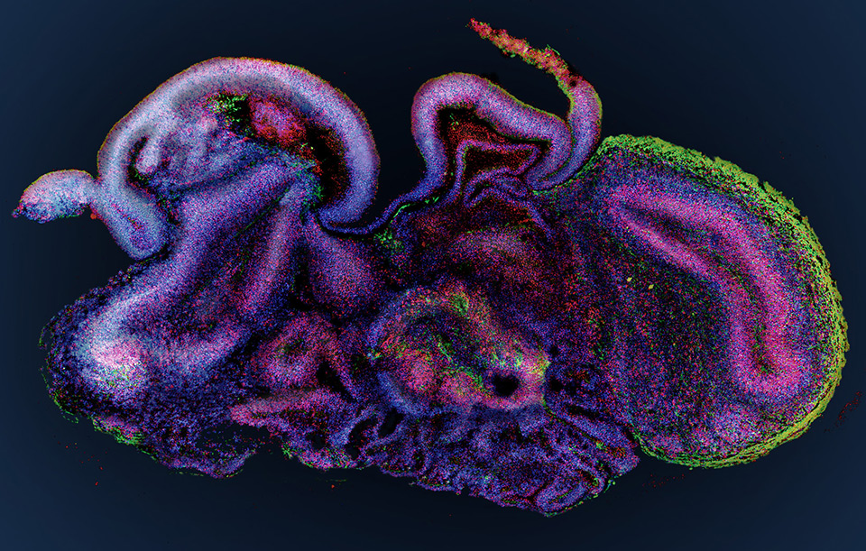
Gene expression profile at single cell level of hippocampal organoids
Anirudh Rao, Govinda K, Nithish Gokul,
Sanyukta Gedam, Shankhanabha Ghosh, Shreeharsha G Bhat

Slide 2

The dataset
Published in the NCBI Gene Expression Omnibus (GEO) on April 20, 2024 by Yan Wu’s group at the Southern University of Science and Technology (SUSTech) in Shenzhen, China
Accession number – GSE264363

Slide 3
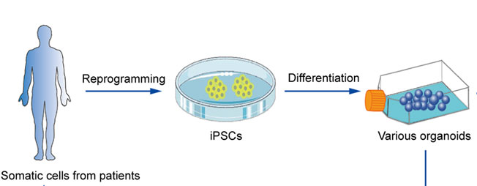
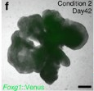
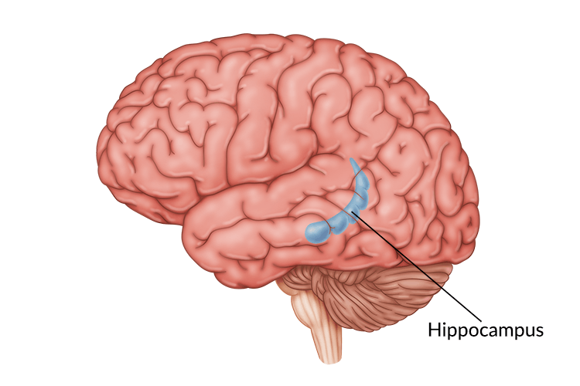
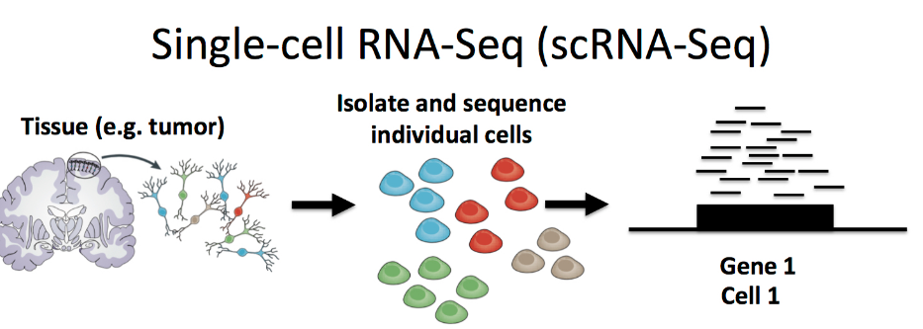
The dataset
Hippocampal organoids were developed from human induced pluripotent stem cells (IPSCs).
Single-cell RNA sequencing (scRNA-Seq) was used to analyse the transcriptome of the organoid, and thus, the cell identities in the organoid.
Samples from Day 70 and Day 81 organoids were used for scRNA-Seq.

Slide 4
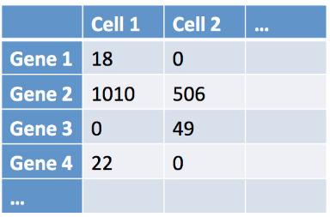
The dataset
Contains 3 files for each organoid – barcodes, features, matrix.
The barcodes file includes information about the cells (2,065,299 cells).
The features file includes information about the genes (33,538 genes).
The matrix file describes the genes expressed in each cell.
On average, a given cell expresses 1500 genes.
On average, a given gene is expressed in 30 cells.

Slide 5

Loading the data and quality control
The data from the 70 day old organoids was read into R and the Seurat library was used for data analysis.
To keep the size of the gene expression matrix reasonable, we removed cells that expressed lesser than 30 genes.
We also removed genes that were expressed in fewer than 1500 cells.
This reduced the number of cells to be analysed to 83,262 and the number of genes to be analysed to 6,488.
Hao, Y., Stuart, T., Kowalski, M. H., Choudhary, S., Hoffman, P., Hartman, A., Srivastava, A., Molla, G., Madad, S., Fernandez‐Granda, C., & Satija, R. (2023). Dictionary learning for integrative, multimodal and scalable single-cell analysis. Nature Biotechnology, 42(2), 293–304. https://doi.org/10.1038/s41587-023-01767-y

Slide 6

Normalisation and Ensembl mapping
We used the default log-normalisation method of the Seurat library.
It normalises the gene expression measurements of each cell by the total expression of that cell.
It then multiples the expression value by a scaling factor of 10,000 and takes the logarithm of the result.
We then mapped the Ensembl IDs given in the features file to their corresponding gene names.

Slide 7
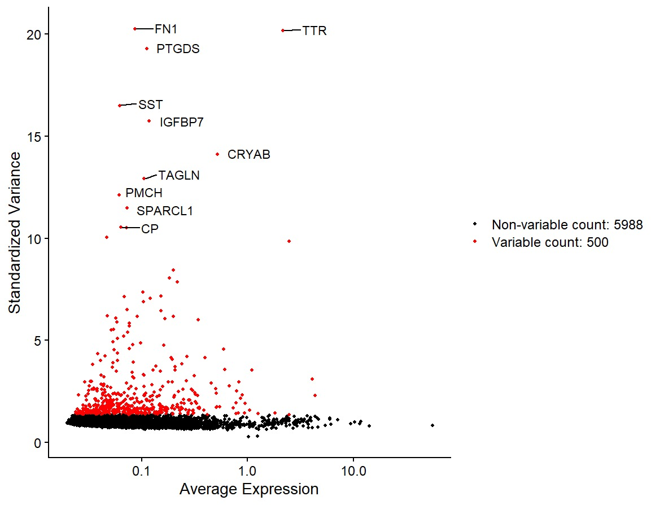
Feature selection
We then identified the top 500 genes that showed the most cell-to-cell variation.
We annotated the top 10 most variable genes in the plot shown on the right.
Fibronectin 1 (FN1) shows the most variance.
MALAT1 has the highest average expression.
MALAT1

Slide 8
Feature selection – Interpretation
FN1 – Fibronectin 1 – Involved in neuroprotection (Wang et al., 2013)
TTR – Transthyretin – Involved in thyroxine and retinol transport, protects against fibril formation in neurons (Li et al., 2011)
PTGDS – Prostaglandin D2 synthase – Synthesises a neuromodulator in the central nervous system (Shimizu et al., 1979)
MALAT1 – Long non-coding RNA expressed ubiquitously in most mammalian cells (Arun et al., 2020)

Slide 9
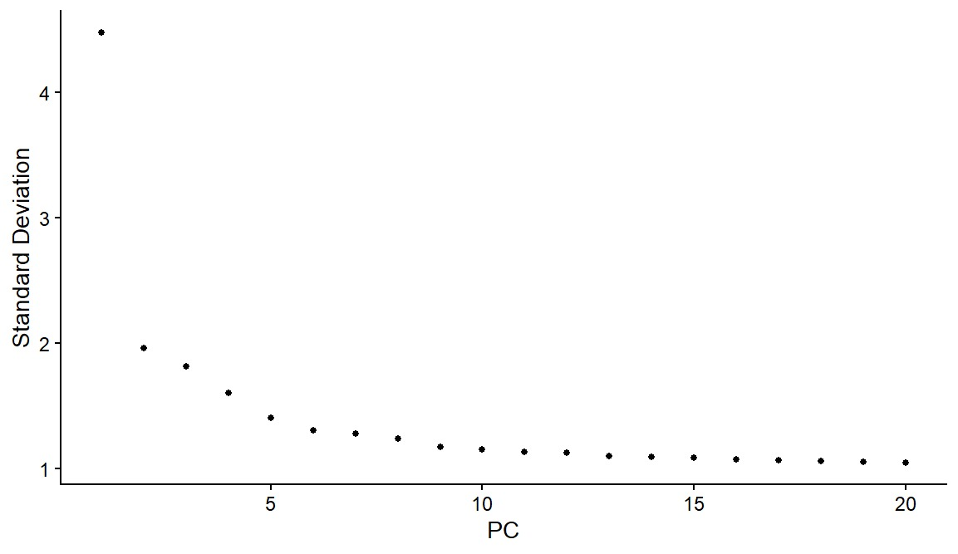
Principal component analysis
After scaling the data, we performed linear dimensionality reduction using PCA.
We then used an elbow plot to determine how the explained variance changed with the principal components found by the algorithm.
We decided to use the first 5 PCs for analysis.

Slide 10
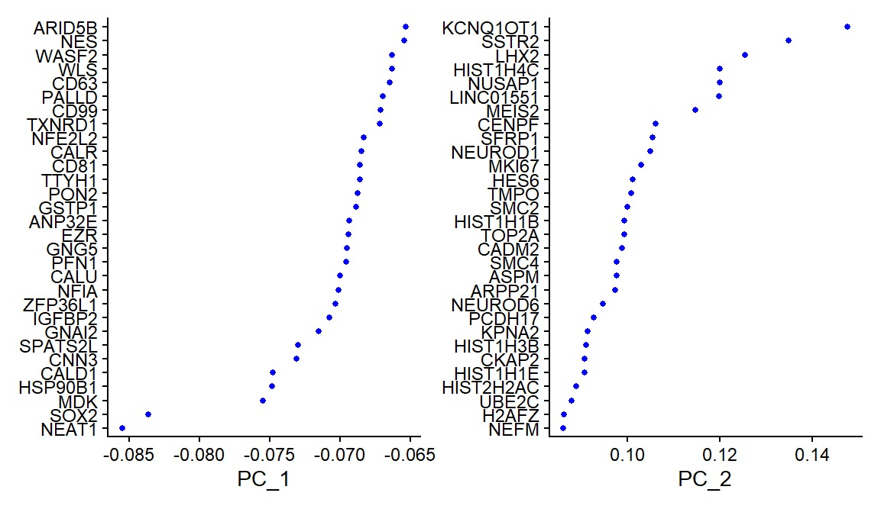
Principal component analysis

Slide 11
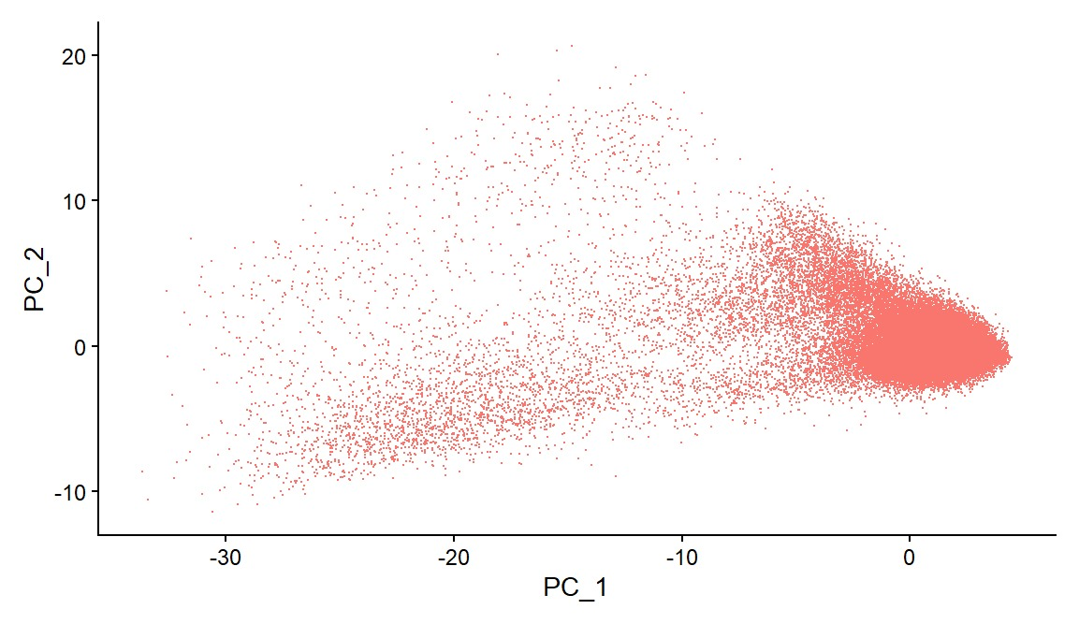
Principal component analysis

Slide 12
UMAP
We then performed non-linear dimensionality reduction using UMAP, considering the first 5 principal components identified by the previous step.
The algorithm returned 7 communities that it found in the data.

Slide 13
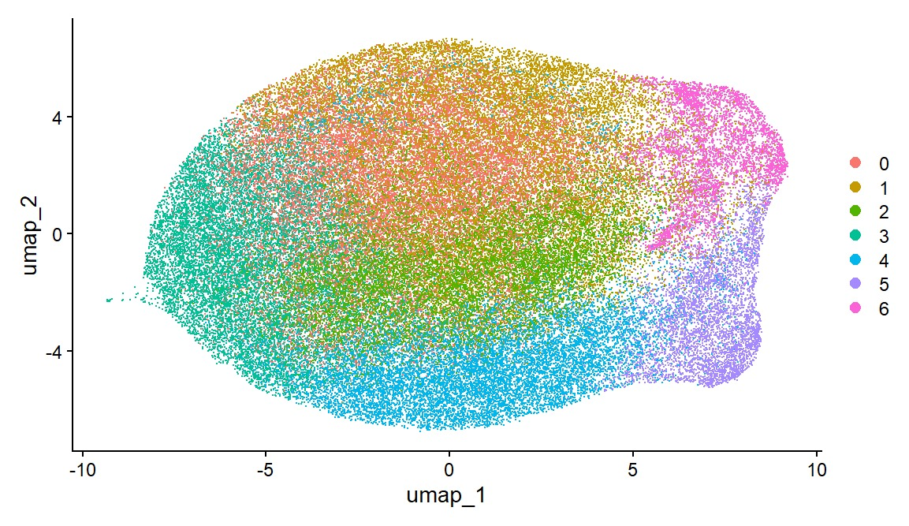
UMAP

Slide 14
Future work
Interpreting UMAP result by identifying the differentially expressed biomarkers in each of the communities.
Assigning cell types to the communities identified by UMAP and comparing to the hippocampus found in vivo.
Comparing the transcriptomic signature and cell composition of 70 day organoids and 81 day organoids.

Slide 15
Thank you

